Slide 1
A DATA-DRIVEN APPROACH AGAINST WEST NILE VIRUS IN CHICAGO
By: Amira, Joseph, Joshua, Nelson, Zhi Hong
DSI-28
10 Jun 2022

Slide 2
TABLE OF CONTENTS
01
02
03
BACKGROUND
DATA CLEANING & EDA
FEATURE ENGINEERING
04
05
06
MODELLING &
EVALUATION
COST-BENEFIT ANALYSIS
CONCLUSIONS & NEXT STEPS

Slide 3
01.
BACKGROUND

Slide 4
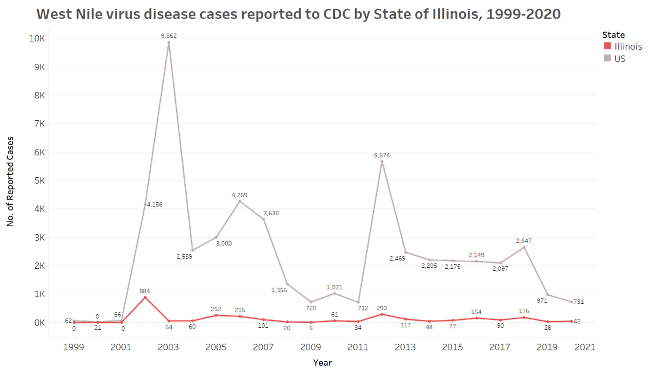
State of Illinois has been effectively tackling
WNV over the past two decades
Source: CDC

Slide 5
Existing surveillance and control strategy is
important to curb the prevalence of WNV in Chicago
Treating catch basins with larvicide to limit mosquito breeding and reduce adult mosquito population density
Setting mosquito traps across the city to detect WNV
Testing dead birds found in the city to detect WNV
Routine spraying of adulticides
Educating the public to proactively reduce no. of mosquitos in their own areas and take personal precaution to avoid bites

Slide 6
We propose to improve the control strategy with
a targeted approach for adulticide sprays
1
Machine Learning Model to accurately
predict WNV occurrence across Chicago
Evaluation Criteria:
High ROC AUC score above 85% on validation set
High ROC AUC score above 70% on truly unseen data
2
Cost Benefit Analysis of adulticide spraying
To quantify spraying costs and external costs of WNV
To weight the benefits of spraying against its costs

Slide 7

02.
Data Cleaning & EDA

Slide 8
Scope of Data
Train Set
Contains data from 2007 - 2013 (2 years interval)
No missing values
Test Set
Data from 2008 - 2014 (2 years interval)
No missing values
Spray Set (Will not use)
Contains data from 2011 and 2013
Missing values in spray timing
Weather Set
Contains data from 2007-2014 (8 years)
Missing values in many columns

Slide 9
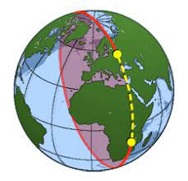
Data Cleaning Process
Dropped non-essential columns
Combined duplicated rows due to mosquitoes count limit
Assignment of stations based on each point’s lat and lon using Haversine Distance

Slide 10
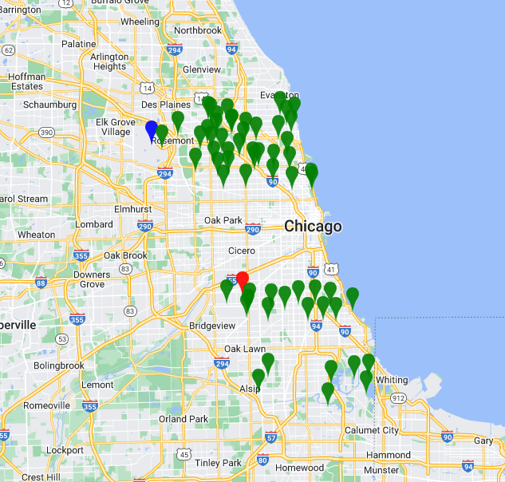



Haversine Distance
Station 1
Station 2
Traps deployed

Slide 11
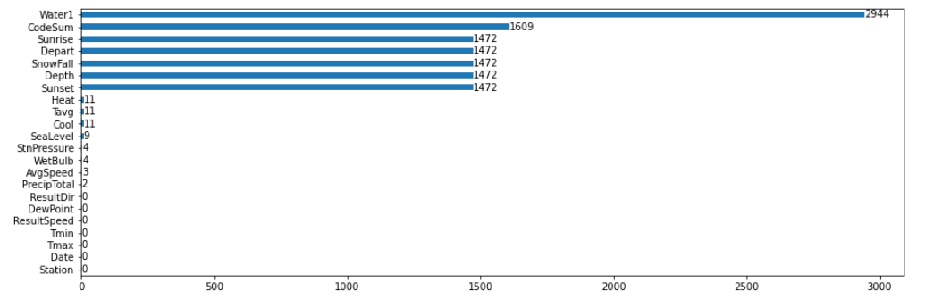
Missing Values
Dropped columns with > 80% data missing
Forward-fill sunrise and sunset
Filling average temp with Min and max
Mean for <0.3% data

Slide 12
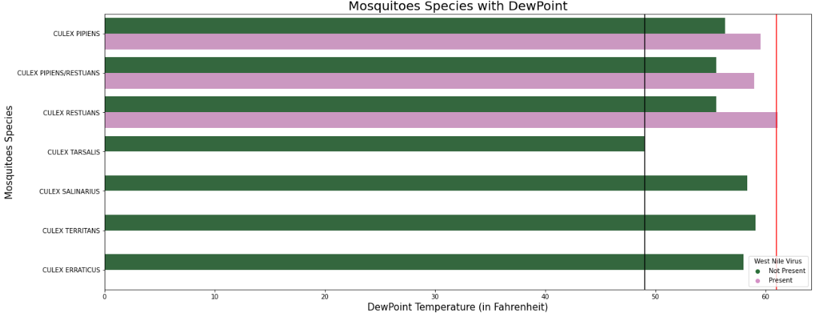
Dew Point Temperature
All mosquitoes species thrives with dewpoint between 49-61 Fahrenheit
Could increase resources when temperatures are within ideal conditions

Slide 13
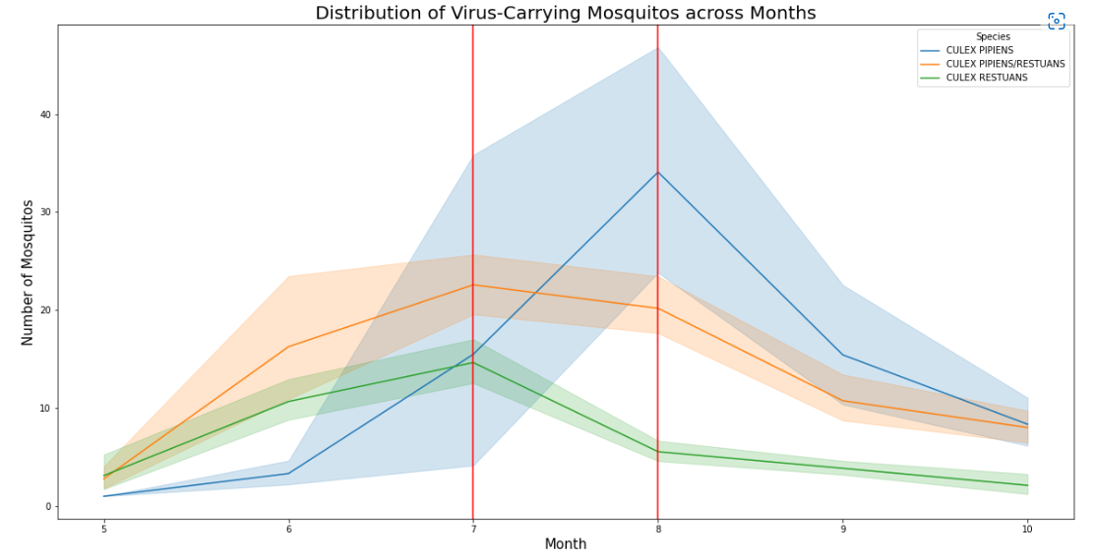
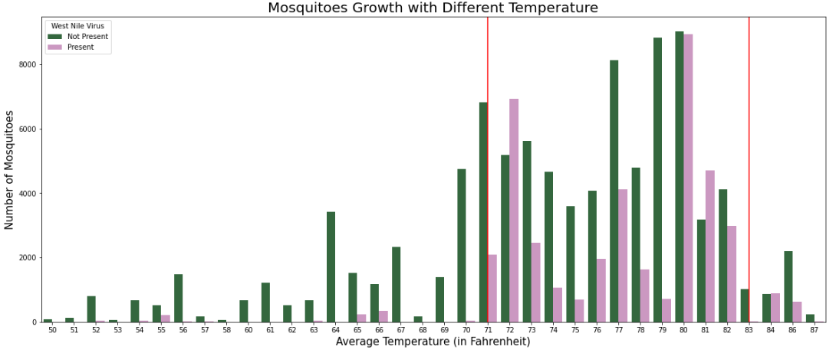
Temperature Change
Mosquito growth starts to peak around July to August
Spike in Mosquito breeding with temperature between 71-85 Fahrenheit (21.6 -29.4 Celsius)

Slide 14
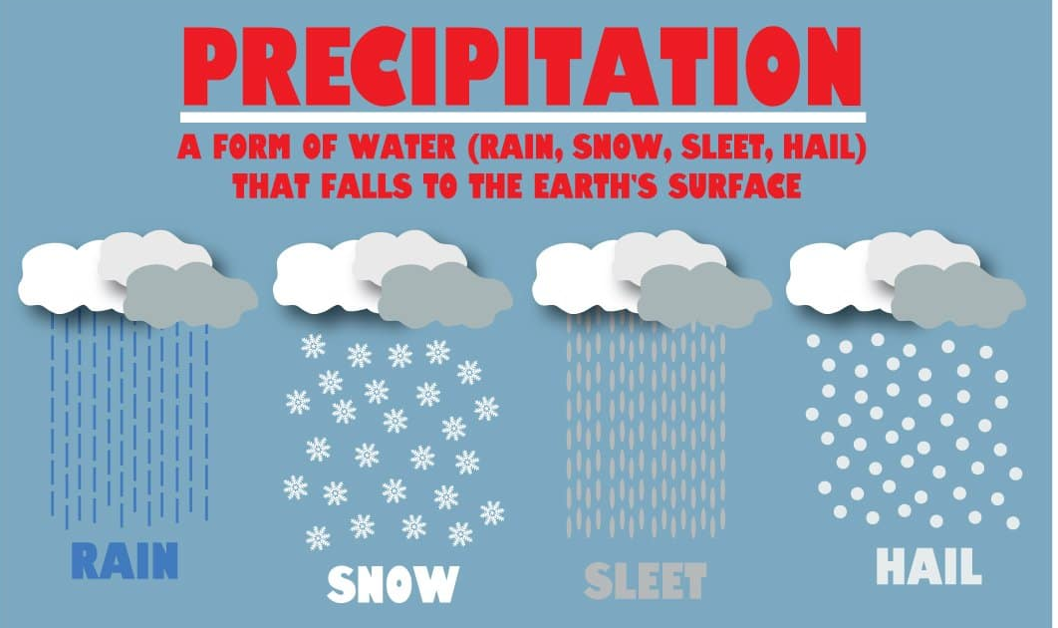
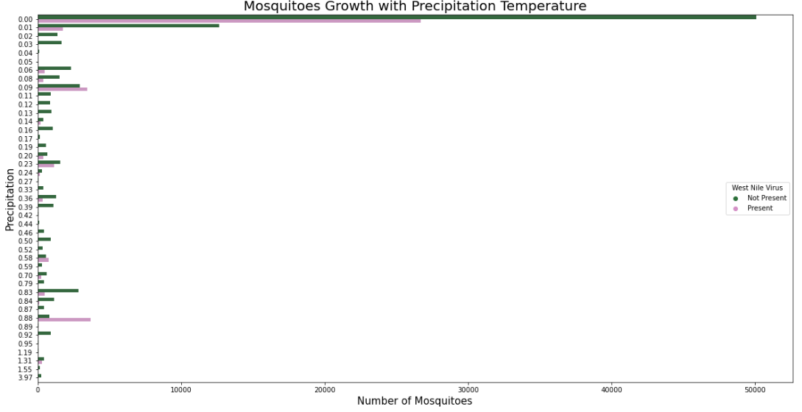
Precipitations

Slide 15
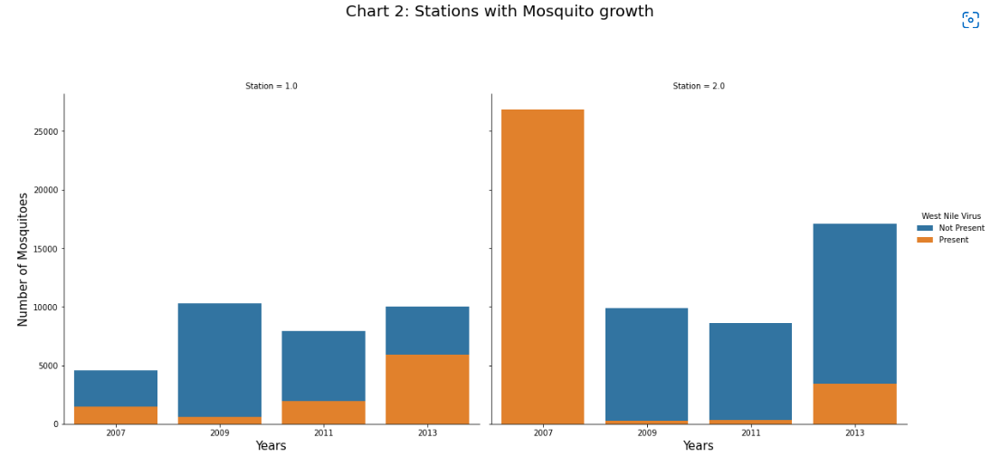
Mosquitoes Locations
Station 2 mosquitoes count is doubled of station 1
Although station 1 count is lower, but WNV is growing/double of station 2
Note: High WNV count in 2007(station 2) is due to WNV present in same trap

Slide 16
03.
FEATURE ENGINEERING
Notes:
Thanks Zhi Hong for the detailed EDA explanation. Next, we’ll move on to feature engineering

Slide 17
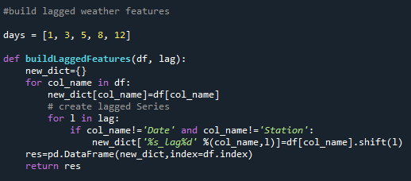
LAGGED WEATHER FEATURES
1, 3, 5, 8, and 12 days lag in weather features
To account for the life cycle of a mosquito, and for the delay required for WNV to be detected
Notes:
There are several featured columns that we created. First of the feature is lagged weather feature. We created 1, 3, 5, 8 and 12 days to account for the life cycle of a mosquito through their different stages. As such, we’ll be able to know the lagged values depending on the cycle the mosquitos are in.

Slide 18
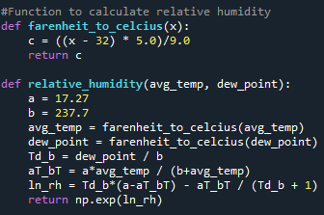
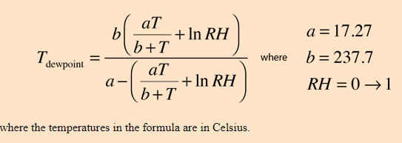
RELATIVE HUMIDITY
Measure of water vapour content in the air
A mosquito’s survival rate reduces as relative humidity falls (3% survival rate at sub 10% Relative Humidity/during dry season)
Notes:
Moving on, we have relative humidity. It’s actually a measure of water vapour content in the air. We used the formulas as shown with respect to the Dewpoint temperature and Average Temperature. It’s correlated to what Zhi Hong mentioned about the dewpoint temperature whereby higher Dewpoint temperature will lead to more mosquitoes and mosquitos thrive better in wet season/ when it’s more humid.

Slide 19
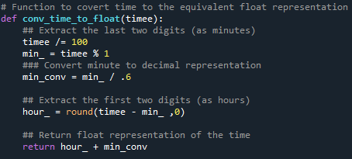
DARK HOURS
Hours in a day where it is night time
Mosquitoes avoids daylights to prevent dehydration from sun exposure, and are most active during the night
Notes:
Lastly, we created Dark Hours which is the hours in a day when it’s night time as mosquitoes usually avoid daylights to prevent dehydration from sun exposure and are most active during the night.

Slide 20
04.
MODELLING
Notes:
We then fed all the engineered columns into our models and proceed to do modelling.

Slide 21
MODELLING
Random Forest Classifier (Baseline)
Adaptive (ADA) Boost Classifier
Gradient Boost Classifier
Stacking Classifier
Notes:
Those are the models that we attempted. Random Forest, ADA boost, gradient boost and stacking classifier. We’ll explain those models as we move on.

Slide 22
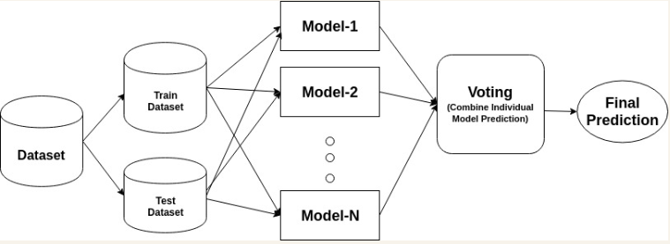
RANDOM FOREST CLASSIFIER
Notes:
For random forest, the model actually splits the dataset into a few subsets of decision tree/models and it will collect the majority outcome from all those subsets of decision tree for predictions.

Slide 23
RANDOM FOREST CLASSIFIER
TRAIN AUC
99.9%
TEST AUC
93.82%
Notes:
We can see that the train and test accuracy scores are relatively high at 99.9% and 93.82%

Slide 24
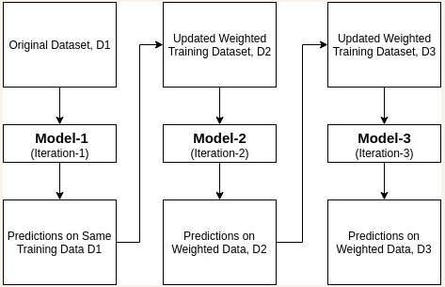
ADA BOOST CLASSIFIER
It’s okay to make mistakes.
Mistakes are our teachers - they help us to learn
John Bradshaw
Notes:
Adaptive boosting takes an approach to turn weak classifiers to strong ones through mistakes learning from each of the classifier iteration. Just like humans learn from their mistakes and try not to repeat them further in life, It will then use every iteration to learn and proceed to the next iteration until the model predicts perfectly.

Slide 25
ADA BOOST CLASSIFIER
TRAIN AUC
98.82%
TEST AUC
93.6%
Notes:
Comparable to random forest, our train and test accuracy scores are also as high as 98.82% and 93.6%. Next, i’ll pass the time to joseph to talk about our next models and model evaluations.

Slide 26
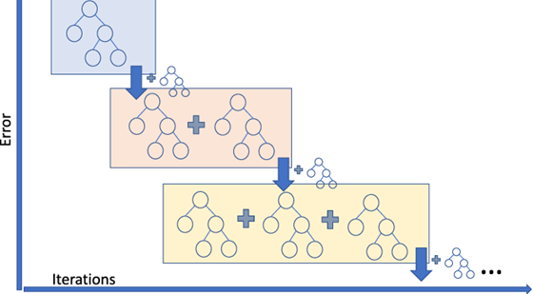
GRADIENT BOOSTING CLASSIFIER
Notes:
Adaptive boosting takes an approach to turn weak classifiers to strong ones through mistakes learning from each of the classifier iteration. Just like humans learn from their mistakes and try not to repeat them further in life, It will then use every iteration to learn and proceed to the next iteration until the model predicts perfectly.

Slide 27
GRADIENT BOOSTING CLASSIFIER
TRAIN AUC
92.57%
TEST AUC
92.715%

Slide 28
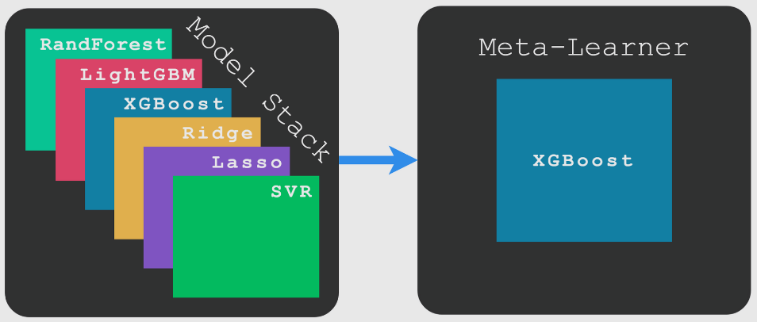
STACKING CLASSIFIER

Slide 29
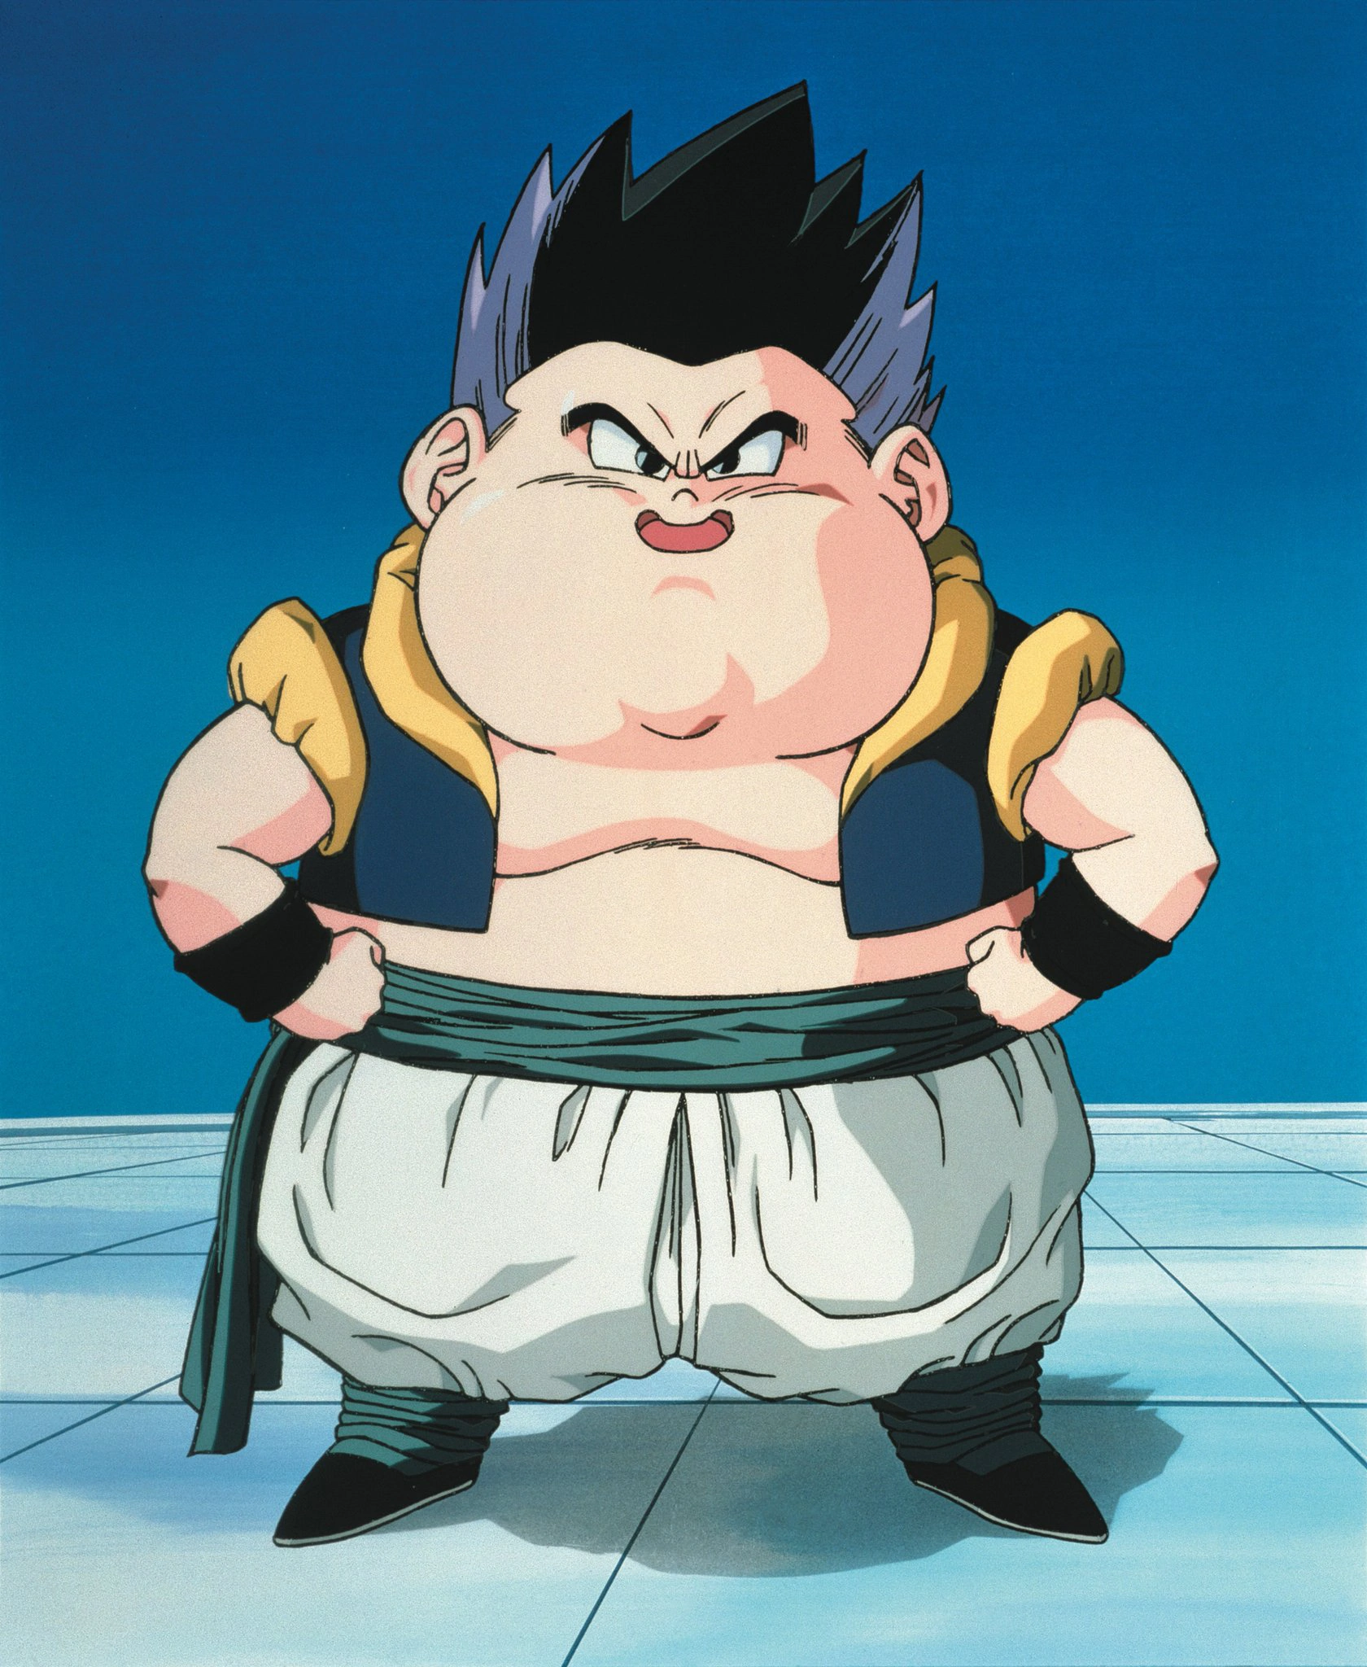
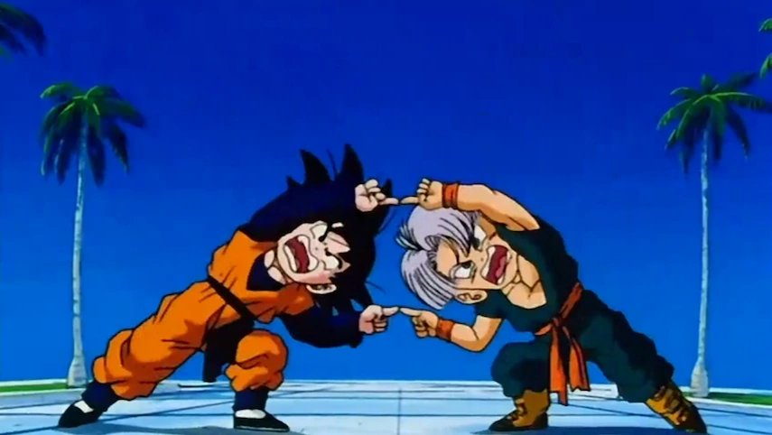
STACKING CLASSIFIER
XGBRF CLASSIFIER
XGB CLASSIFIER
RANDOM FOREST CLASSIFIER
EXTRA TREE CLASSIFIER
GB CLASSIFIER
ADABOOST CLASSIFIER
XGBCLASSIFIER (GBTREE)
RIDGE CLASSIFIER

Slide 30
STACKING CLASSIFIER
TRAIN AUC
98.6%
TEST AUC
97.85%

Slide 31

MODEL EVALUATION
RANDOM FOREST | ADABOOST CLASSIFIER | GRADIENT BOOSTING | STACKING CLASSIFIER
99.99% | 98.82%
93.82% | 93.6%
67.85% | 72.72% | 60.91% | 71.33%
TRAIN
92.57%
98.6%
TEST
92.715%
97.85%
UNSEEN

Slide 32
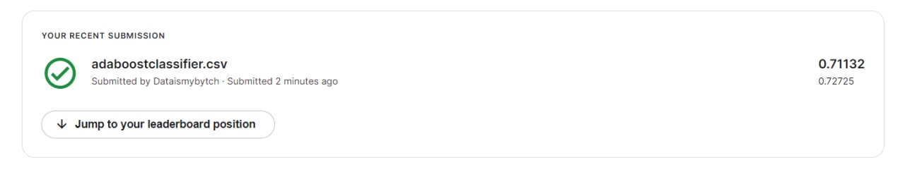
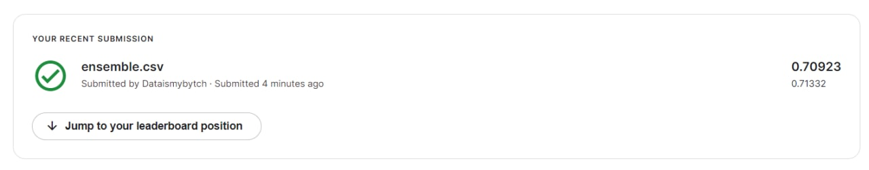
MODEL SELECTION
Run time = 30 secs
Run time = Let's not talk about it (30min)

Slide 33
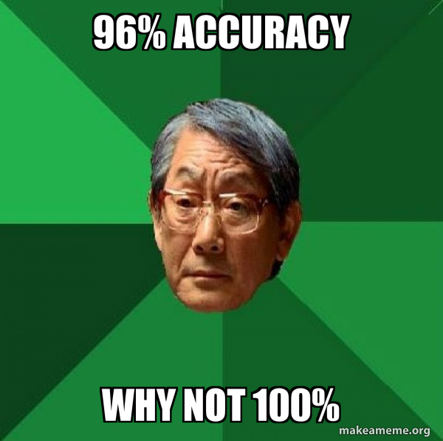
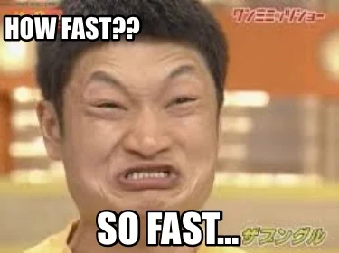
MODEL SELECTION

Slide 34

05.
Cost-Benefit Analysis

Slide 35
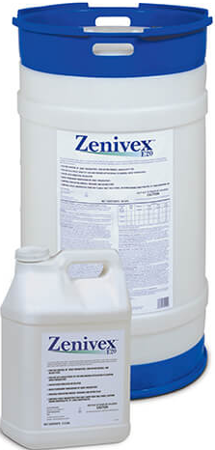
Costs
Direct costs
Indirect costs
Procurement of adulticides (275-gal Zenivex e20)
Healthcare costs
Productivity loss (severe symptomatic patients)
Notes:
Manpower costs (Mosquito control trucks drivers) ^ area for improvement

Slide 36
How much will it cost to spray Zenivex
adulticide across the entire of Chicago annually?
Land Area of Chicago: ~ 145,745 acres (606 km2)
Cost of Zenivex per acre: $0.67
Cost of spraying Chicago (fortnightly) in a year: ~ $2.5 million

Slide 37
Station locations
Surrounding area of station 1
Surrounding area of station 2
Traps deployed

Slide 38
WNvPresent count by Stations
Wnv Present
The WNV is more prevalent
In Station 2 than Station 1
Station 2
Station 1

Slide 39
How much will it cost to spray Zenivex
adulticide only at areas surrounding each station?
Our model predicted Station 2 to capture the presence of WNV at a higher incidence.
Surrounding Land Area of Station 1 & 2: 77 839 acres (315km2)
Cost of Zenivex per acre: $0.67
Cost of spraying targeted trap locations (fortnightly): ~$1.36 million
Notes:
Station 2 or 1
Calculate area of station 1/2

Slide 40
High medical costs and productivity loss due to severe WNV cases
 | Per WNV case# | 60^ WNV cases / year
Hospitalization Cost+ per WNV case | $40,000 | $2,400,000
Productivity Loss* per WNV case | $11,000 | $660,000
Total Costs | $ 51,000 | $3,060,000
* Productivity loss refers to those incurred by both patients/caretakers.
+ Hospitalization cost refers to inpatient costs, outpatient costs and long-term medical costs.
# WNV cases here refer to patients who have developed neuroinvasive symptoms from WNV and require medical attention.
^ Chicago Dept of Health summary report of the 2012 season

Slide 41

Comparison of Direct/Indirect Costs
$3.06 million (indirect costs) - $1.36 million (direct costs) = $ 1.7million
Yes - this project is financially feasible.

Slide 42
CONCLUSION
1
Best Model: ADABoost Classifier
High AUC ROC score on test set: 0.96
High AUC ROC score on Kaggle: 0.72
Prediction can be further enhanced with more recent datasets
2
Benefits of spraying Zenivex adulticide outweigh its costs
Minimise high medical costs and productivity loss to the community
Cost-benefit analysis can be further improved with more data points e.g. impact of neighbourhood types (residential or industrial) and presence of known water basins/ponds/drains where mosquito breeding is more likely to occur; impact of larvicide

Slide 43
NEXT STEPS
Collaborate with meteorologists and researchers to further investigate the impact of weather and seasons
on occurrence of WNV
Improve data collection on adulticide sprays conducted in the city to accurately track the effectiveness of sprays in curbing the spread of WNV
Engage with research scientists to further investigate the virus-carrying mosquito species (Culex Pipiens & Culex Restuans) to find other methods to effectively inhibit their growth and spread

Slide 44
THANK YOU

Slide 45
References
https://www.chicago.gov/content/dam/city/depts/cdph/statistics_and_reports/CDInfo_2013_JULY_WNV.pdf
https://www.cdc.gov/westnile/statsmaps/cumMapsData.html#one
https://dph.illinois.gov/topics-services/diseases-and-conditions/west-nile-virus.html

